Slide 1


Flight Delays
Team Members
Asma-Ul-Hushna
Xubin Zhao
Yaxal Arenas

Slide 2
Presentation Contents
Project Overview
Knowing The Data
Data pipeline
Final Features and The Target
Preparing the data
Train set, test set
The code
Models
Logistic Regression
Random forest
PCA to Speed up Machine Learning Algorithms (Decision Tree)
Stochastic Gradient Boosting
SGDClassifier
Neural Network –Deep Learning
Evaluate the models - analyzing model results
Comparing models
Conclusions

Slide 3

Data
Project Overview
In 2015 there are lots of flight delays in United States for some reason. Nearly one third of all flights in our data set have delays. The main reasons for flight delays are whether related but in some cases there are also airline or airport related flight delays. In this document we will try to predict if a flight will be Delayed or not on the basis of some given features.
From https://www.kaggle.com/usdot/flight-delays

Slide 4
Knowing The Data
Three separate csv files
Each entry of the 'flights.csv' file corresponds to a flight
More than 5,800,000 flights have been recorded in 2015
Each flight described according to 31 variables
No missing values after filtering out ‘Cancelled’ and ‘Diverted’ flights
Join flights and airlines data
Airports dataset not used for this project
Files | Shape
flights.csv | (5819079, 31)
airlines.csv | (14, 2)
airports.csv | (322, 7)

Slide 5
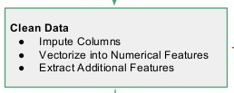
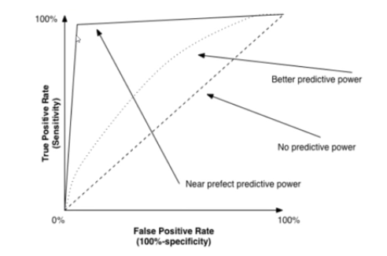
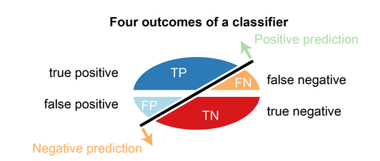
Data pipeline
Data
Features
Target
Data pipeline
Train
Test
Prepare the data
Drop label column from train set
Categorical
Numerical
Confusion matrix
Combining the pipelines together
ROC
Build model
Build model
Fit(X_train, y_train)
Fit(X_train, y_train)
ROC
Confusion matrix
Compare models

Slide 6
Final Features and The Target
Categorical Features
MONTH - Month of the Flight Trip
DAY_OF_WEEK - Day of week of the Flight Trip
AIRLINE - Airline Identifier map to full airline name
SCHEDULED_ARRIVAL - Planned Arrival Time map into 4 categories: early morning, morning, afternoon, evening
Numerical Features
DEPARTURE_DELAY - Total Delay on Departure
TAXI_OUT - The time duration elapsed between departure from the origin airport gate and wheels off
WHEELS_OFF - The time point that the aircraft's wheels leave the ground
SCHEDULED_TIME - Planned time amount needed for the flight trip
DISTANCE - Distance between two airports
Target
ARRIVAL_DELAY = ARRIVAL_TIME-SCHEDULED_ARRIVAL
map to binary data
>= 15 min delay = 1
< 15 min delay = 0
Categorical
Numerical

Slide 7
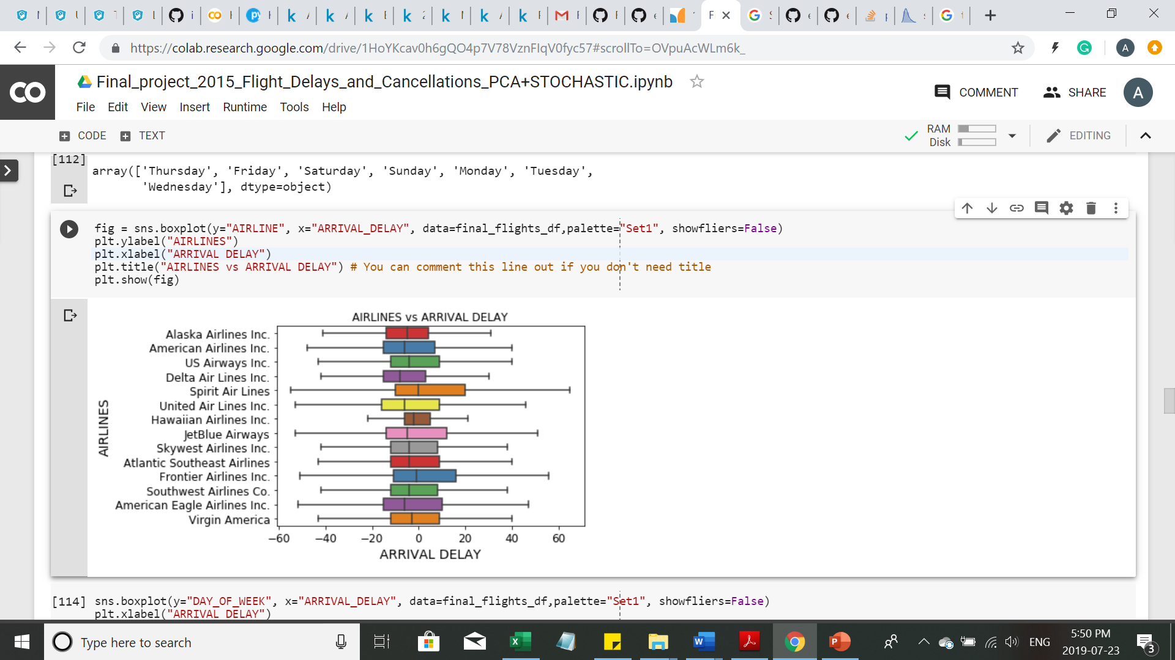
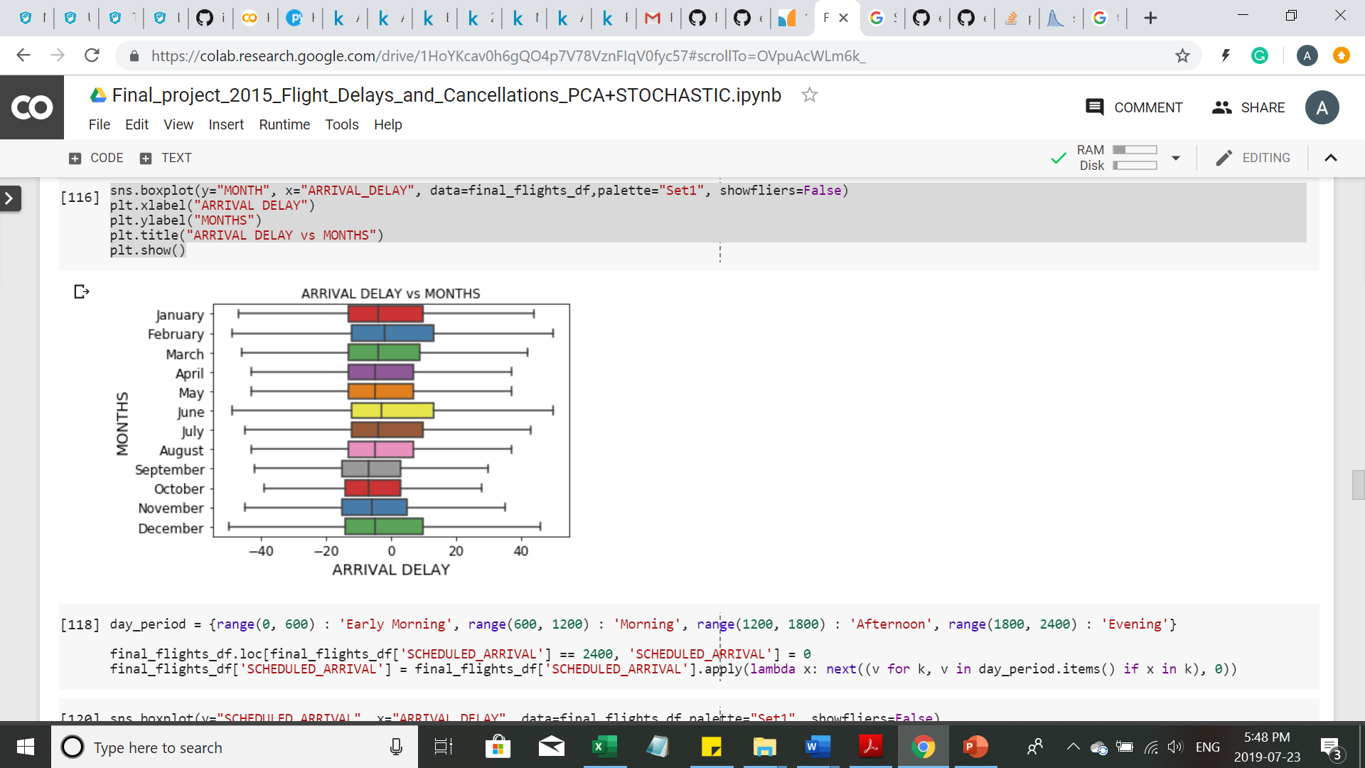
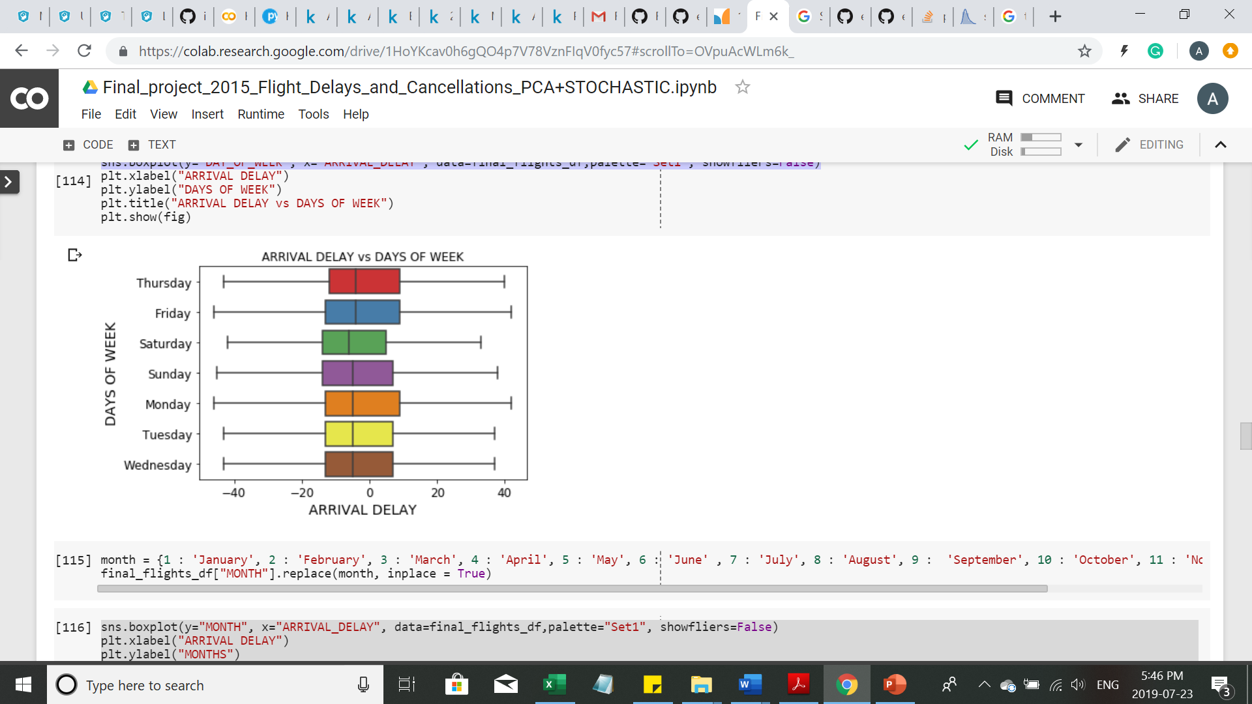
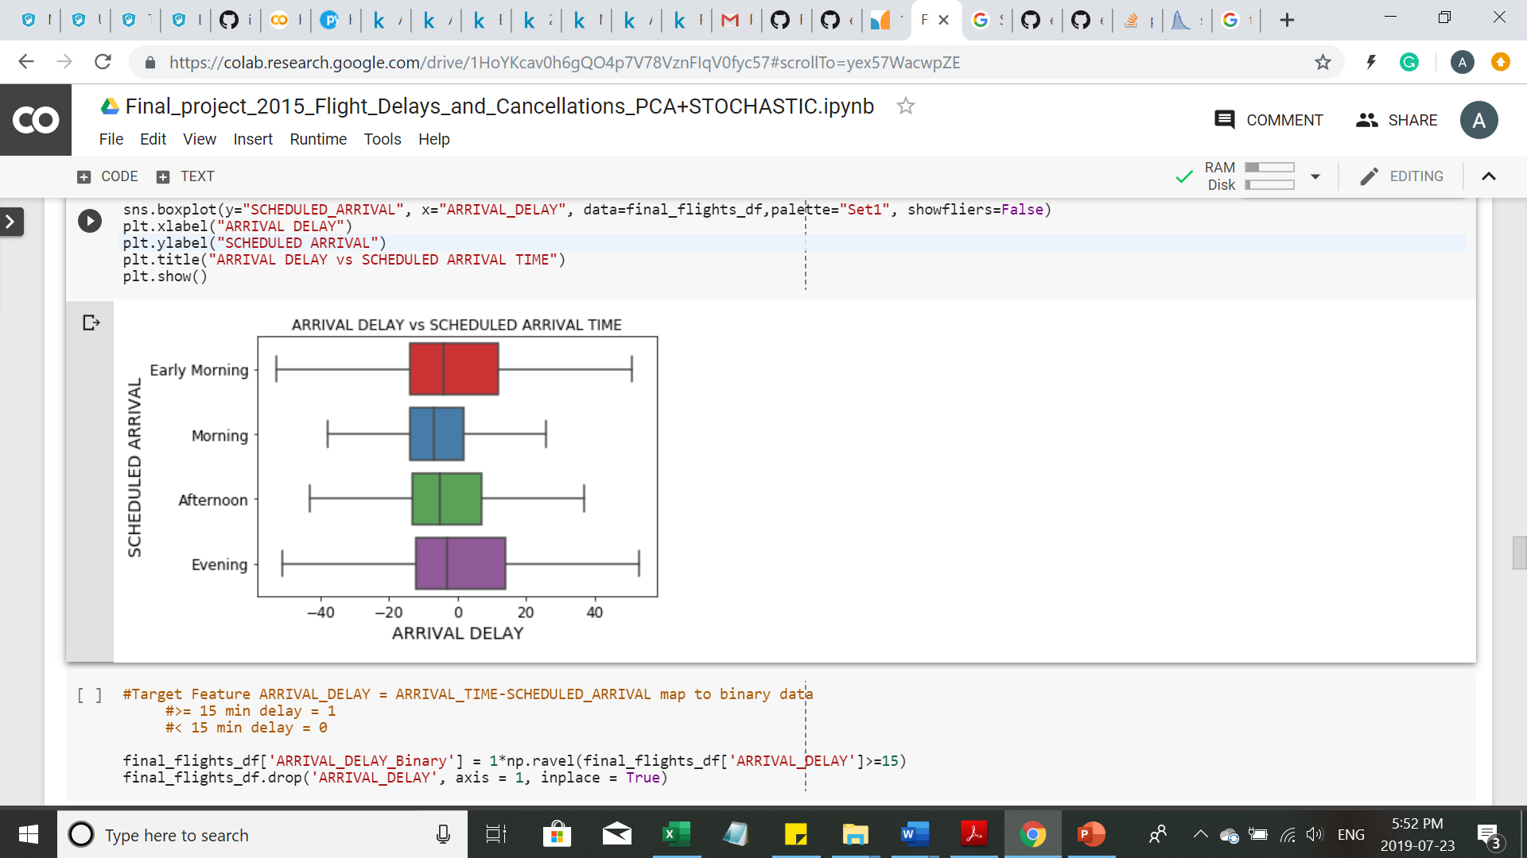
Visualizing Relationship with Categorical Data

Slide 8
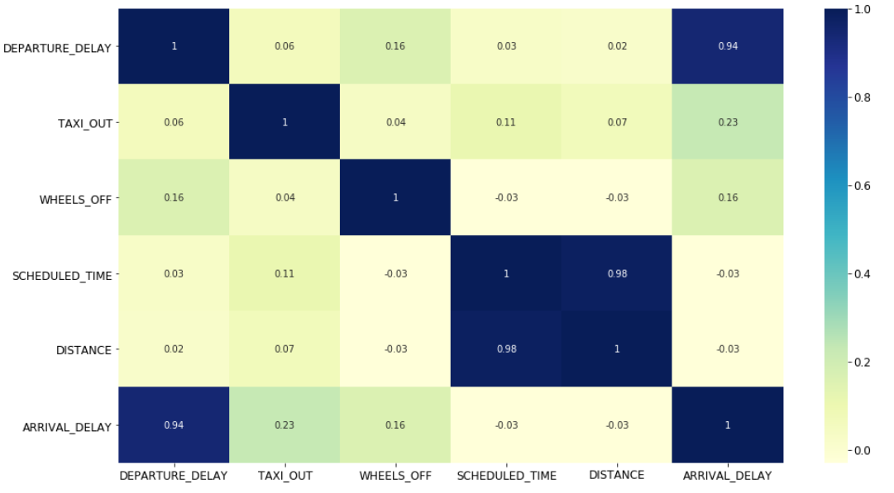
Correlation with Numerical Data

Slide 9
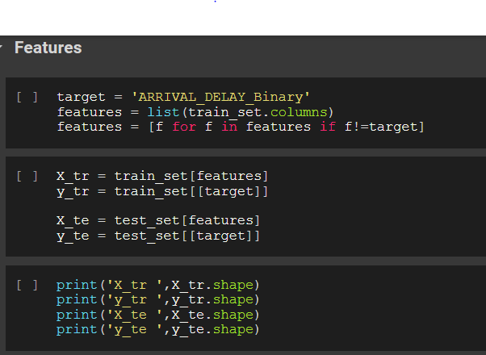
Preparing The Data train_set,test_set
train_set,test_set = train_test_split(final_flights_df, test_size = 0.3, random_state = 42)
Train
Test

Slide 10
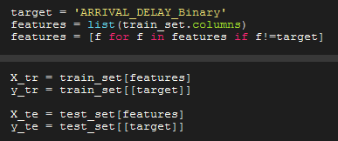
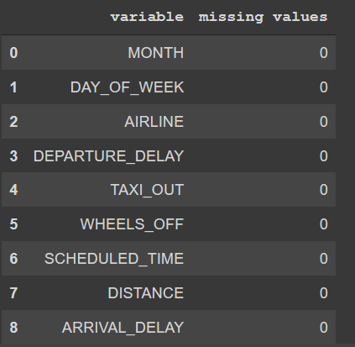
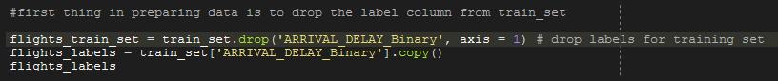
Preparing The Data: The code
Train
Drop label column from train set

Slide 11
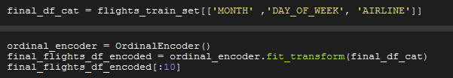
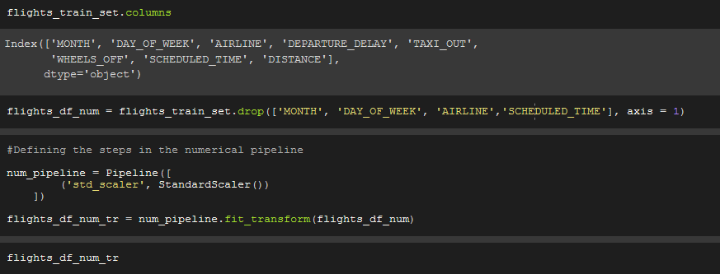
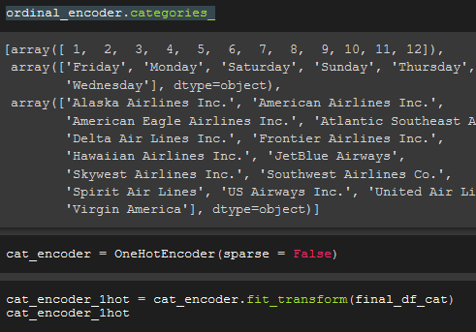
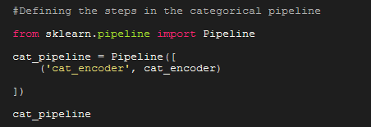
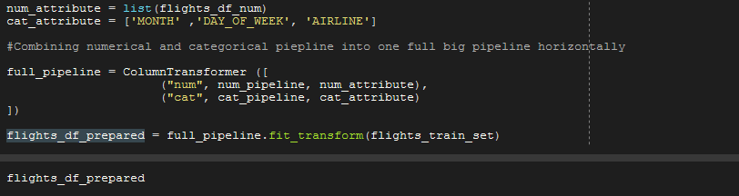
Preparing The Data: The code
Categorical
Numerical
Combining the pipelines together

Slide 12
Models
Algorithm | Training Accuracy | Test Accuracy
Logistic Regression | 0.94641 | 0.94649
Random Forest | 0.95903 | 0.94357
Stochastic Gradient Boosting | 0.94600 | 0.94587
SGDClassifier | 0.94682 | 0.94693
Neural Network | 0.9450 | 0.94522
Neural Network with PCA | 0.9442 | 0.94432

Slide 13
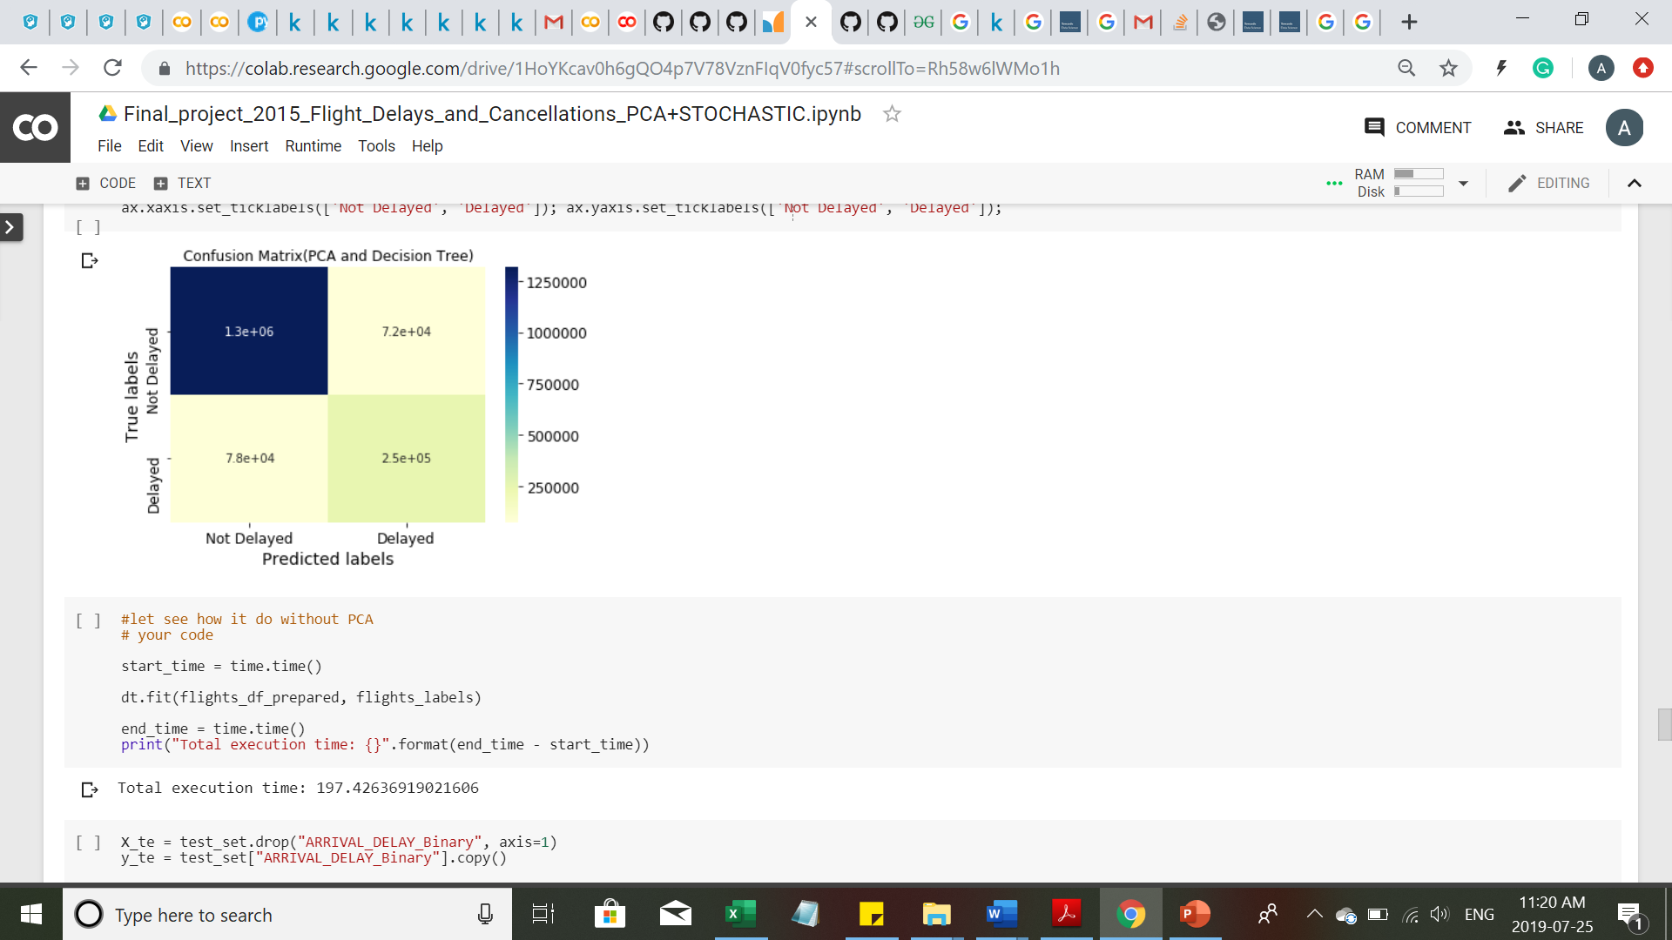
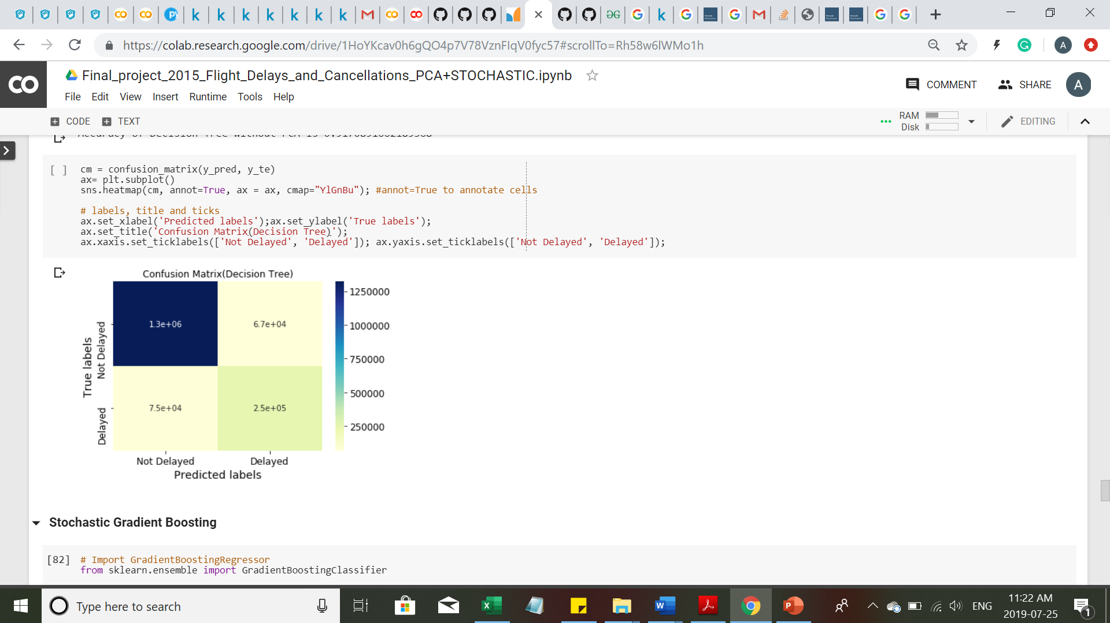
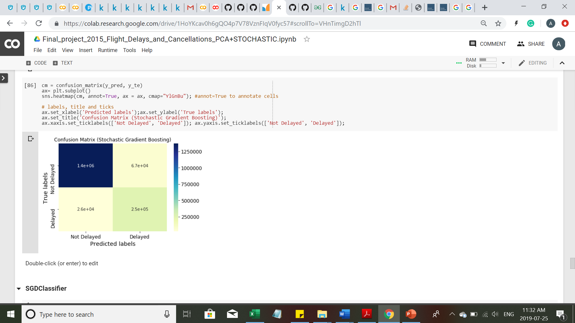
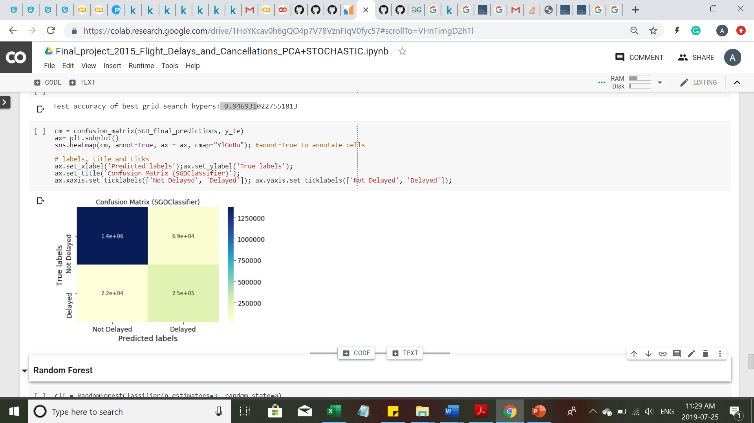
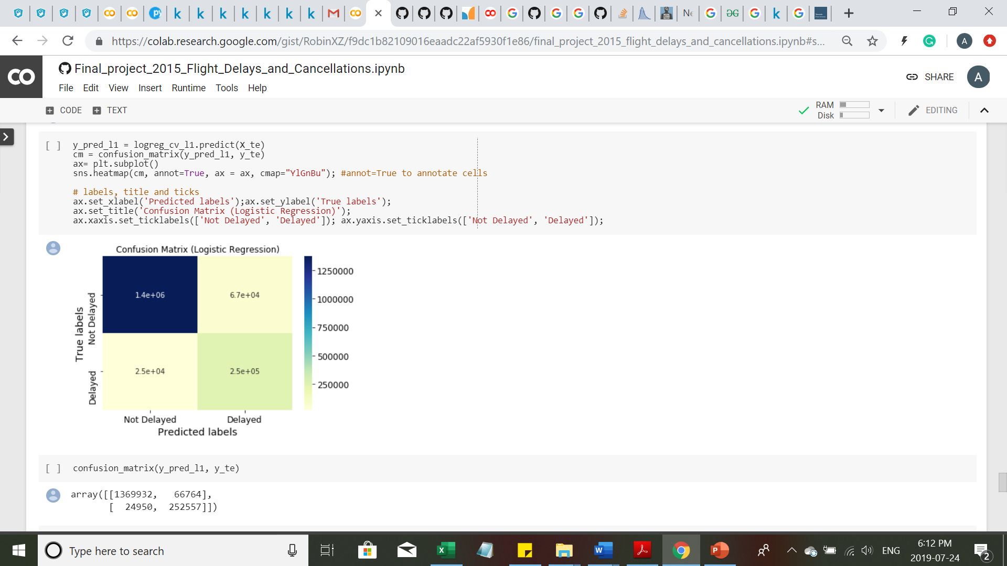
Confusion Matrix of Different Models
ACCURACY
PCA and Decision Tree 0.912149
Decision Tree 0.91708
Stochastic Gradient Boosting 0.94587
Logistic Regression 0.94649
SGDClassifier 0.94693

Slide 14
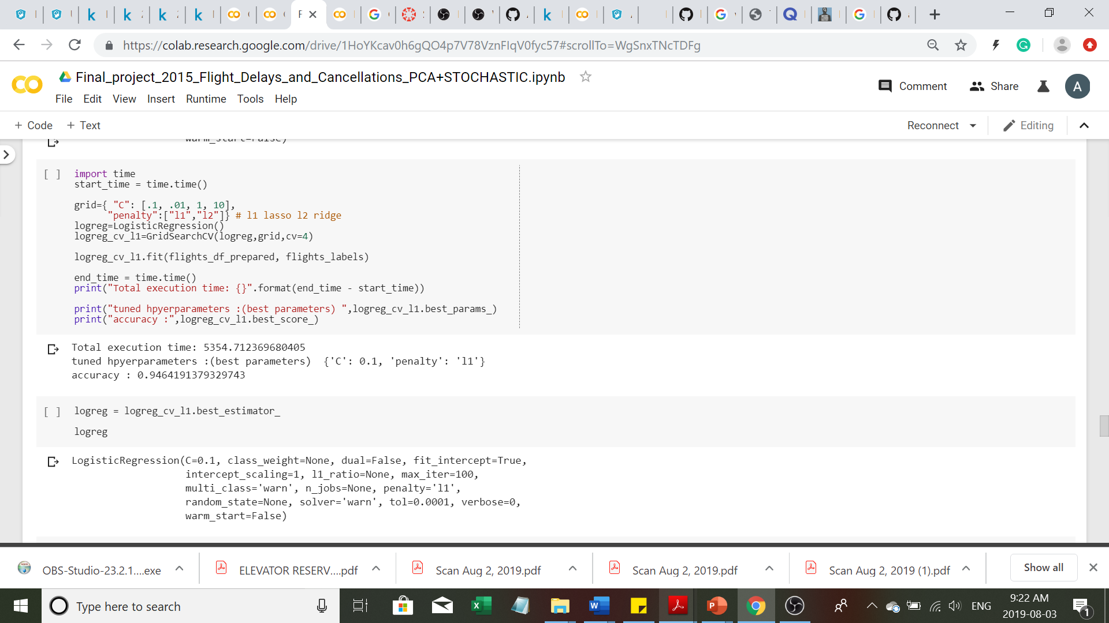
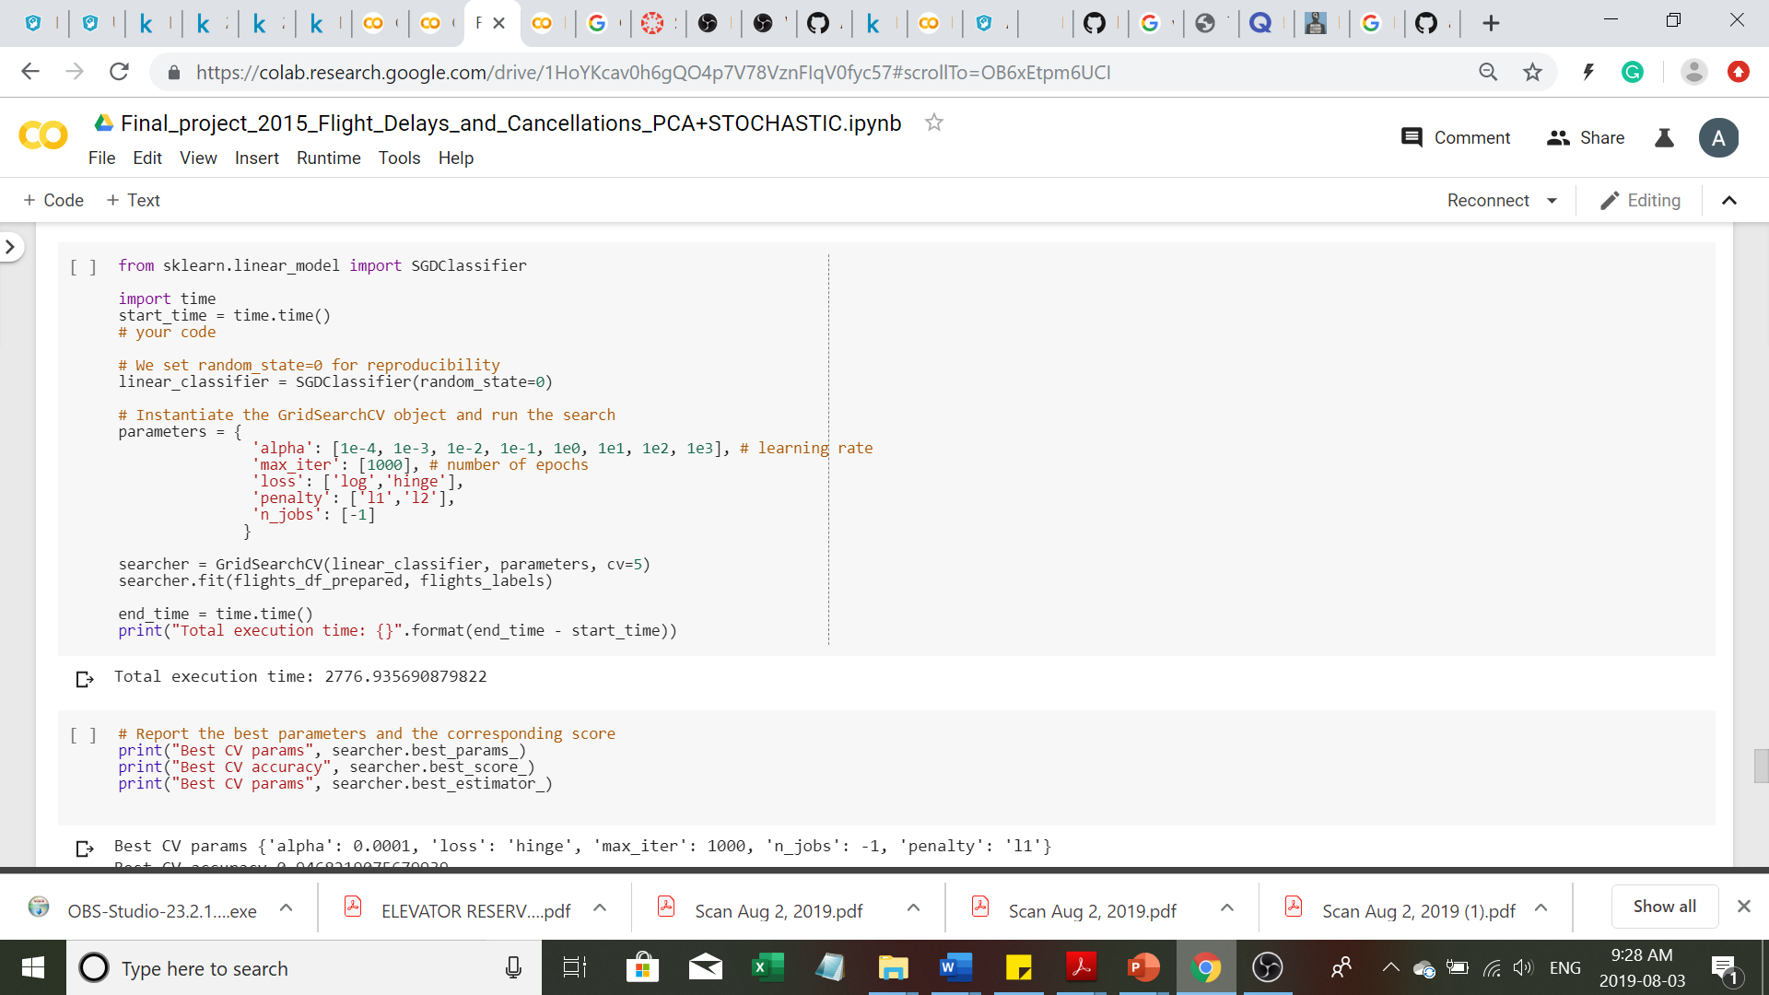
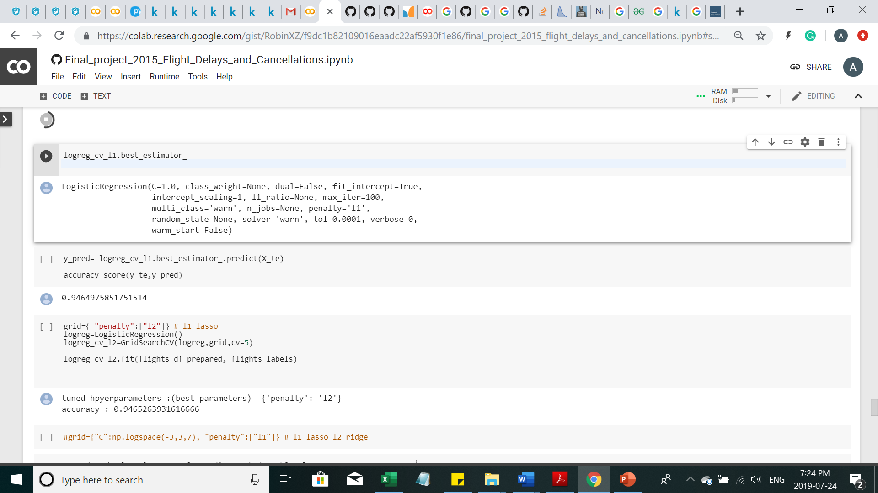
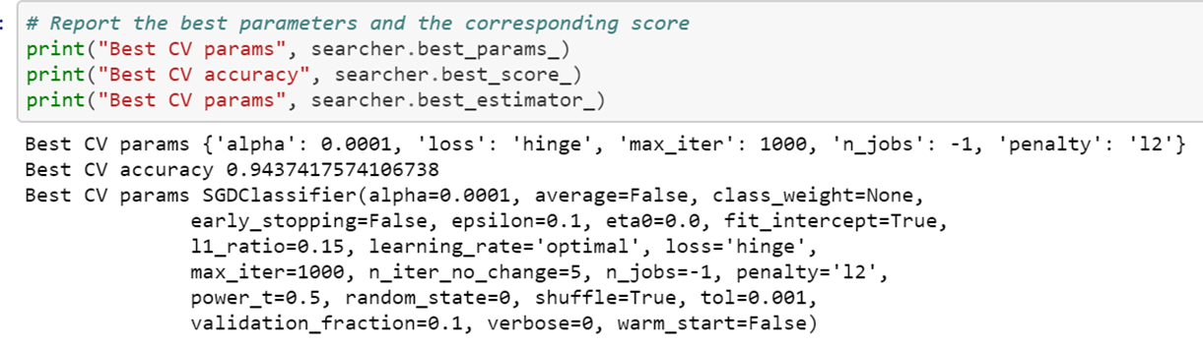
Logistic Regression vs SGD Classifier
To perform as well as the Logistic Regression, SGD Classifier requires some hyper parameter tuning
Logistic Regression took more than 1.5 hours and SGD Classifier took 45 minutes to find the best model

Slide 15

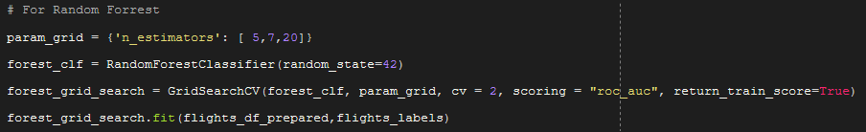
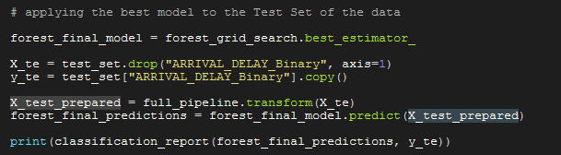
Random Forest
Random Forest test
Random Forest Optimization
forest_grid_search.best_params_ 20
forest_grid_search.best_score_ 0.952

Slide 16
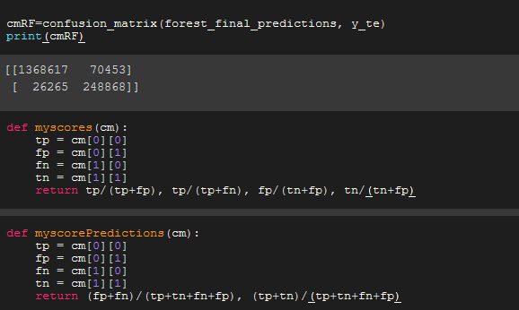
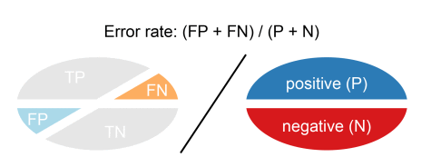
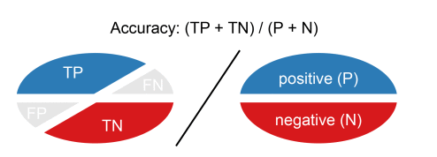
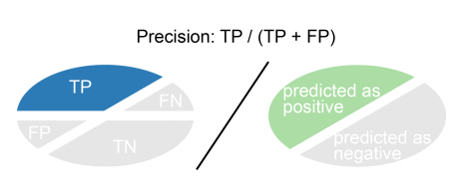
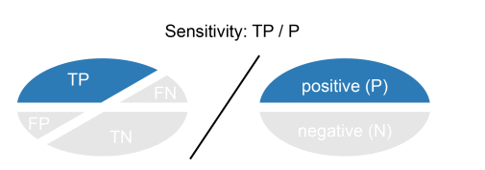
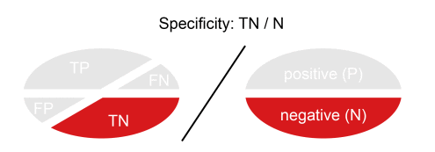
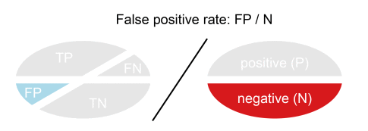
Random Forest results
1368617
Using the confusion matrix
Random Forest results
Error rate =0.056
Accuracy=0.943
Precision =0.951
Sensitivity =0.981
Specificity(true negative)=0.779
False positive =0.22
[1368617 70453] [ 26265 248868]

Slide 17
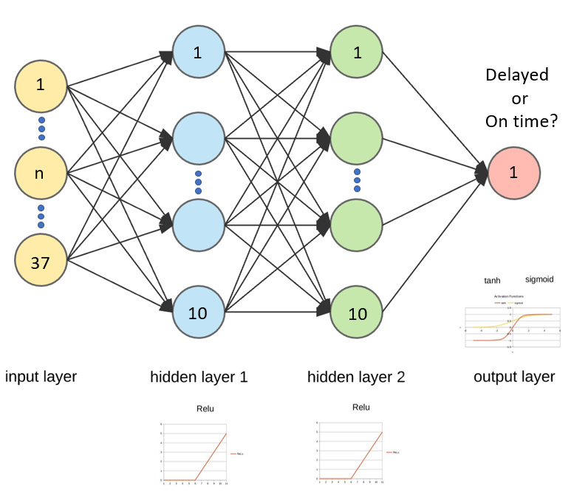
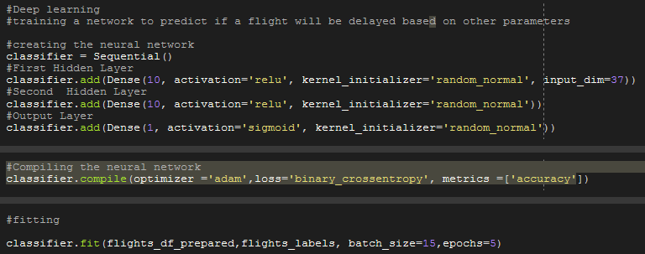
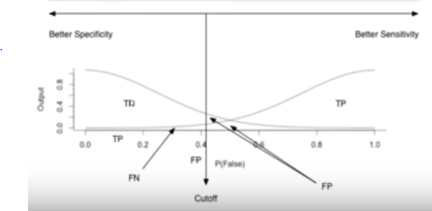
Neural network
Neural network results
Loss = 0.153
Accuracy = 0.945
Error rate =0.054
AUC =0.964

Slide 18
Neural network results
Using the confusion matrix
Neural network results
Error rate =0.054
Accuracy=0.945
Precision =0.981
Sensitivity =0.952
Specificity(true negative)=0.907
False positive =0.092
[1369434 25448] [ 68448 250873]

Slide 19
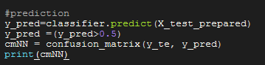
Comparing Models: Confusion matrix
Neural Network Results
Error rate =0.054
Accuracy=0.945
Precision =0.981
Sensitivity =0.952
Specificity(true negative)=0.907
False positive =0.092
Random Forest Results
Error rate =0.056
Accuracy=0.943
Precision =0.951
Sensitivity =0.981
Specificity(true negative)=0.779
False positive =0.22

Slide 20
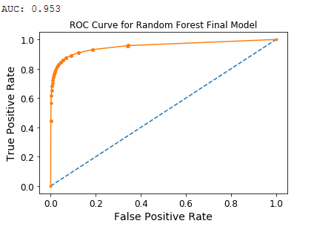
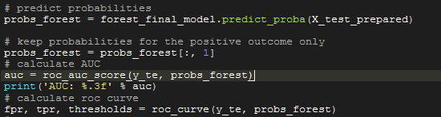
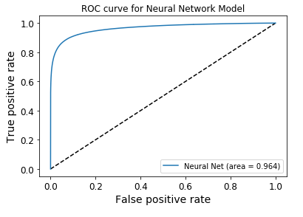
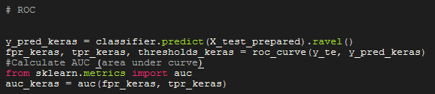
Comparing Models: ROC

Slide 21
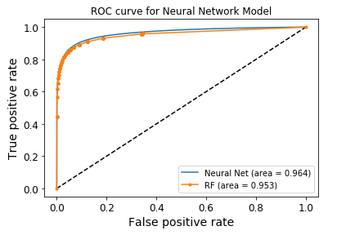
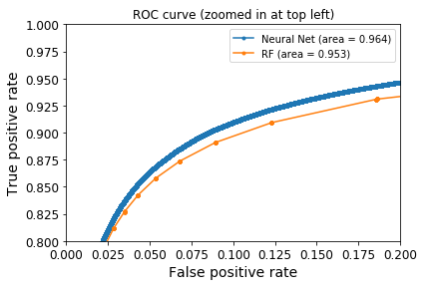
Comparing Models: ROC
Difference of 1.14%

Slide 22
Conclusions
The percentage of planes late in 2015 is 35.86 The percentage of planes right on time in 2015 is 2.17 The percentage of planes that arrived ahead of time in 2015 is 60.16
Stochastic Gradient Boosting is the best Model in terms of accuracy (0.94587), time required(17 min) and memory usage.
We can get equivalent performance from SGDClassifier in half of the time taken by Logistic Regression
For sufficiently large datasets, it is best to implement SGD Classifier instead of Logistic Classifier to produce similar results in much less time
A simple Neural Network has a higher predictive capacity than classic methods (1.14% better)
Calculation time for a Neural Net with 5 epochs was 2.2 h, too long compared to classic methods
Future work
Implement regression analysis to predict ARRIVAL_DELAY.
Optimize the neural network to decrease time yet not losing accuracy, by changing: number of layers, activation type, number of neurons, batch size, epochs.

